Slide 1

Code and Create Bootcamp Capstone Project
DATA ANALYSIS : GROUP 5 OCTOBER, 2025

Slide 2
GROUP NAME : TEAM INFOSCOUT
GROUP TOPIC : DS JOB HR ANALYTICS
MEMBERS: EDEH OGECHUKWU EVELYN CCB/DA/060 ~ (Group Captain) EGHEKAIRE OGHENETEJIRI CCB/DA/062 OKOYE CHIBUIKE LIVINUS CCB/DA/056

Slide 3
JOB DESCRIPTION:
The dataset represents job listings for Data Science and Analytics roles from multiple companies
The goal is to help the HR analytics team and career advisory units understand:
• What factors influence salary estimates and company ratings.
• Which industries and locations offer the best opportunities, and
• How company attributes like size, founding year, and ownership affect
job prospects.

Slide 4

PROPOSED SOLUTION OVERVIEW:
Team InfoScout aims to clean and analyze the “DS Jobs dataset” using Excel and SQL in other to reveal key factors influencing salaries, ratings, and job trends, and more importantly to present insights visually.

Slide 5
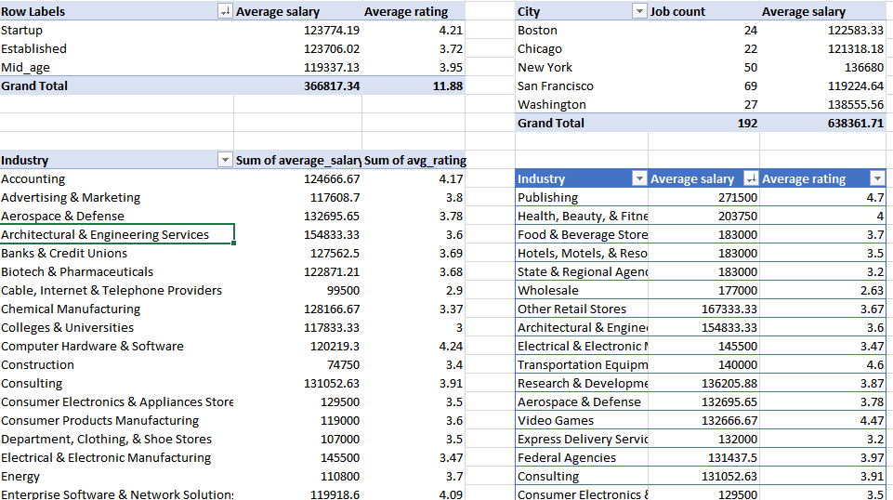
APPROACH (SQL + EXCEL)
SQL: Cleaning + salary parsing + group aggregations.
EXCEL: Visualization + KPI dashboards + interactive slicers.
Combined quantitative & visual story telling for HR decision making.

Slide 6
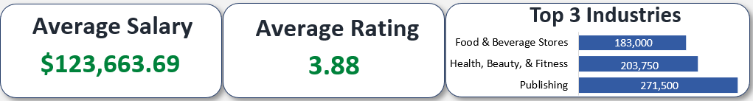
EXECUTIVE SUMMARY
500 + Data Science & Analytics job listings analyzed Objective : To understand salary and rating drivers, top industries and location Average salary ≈ $124k Average rating ≈ 3.9 Tech & Finance = best combination of pay + rating Established firms pay ≈ 20 % more than Startups

Slide 7
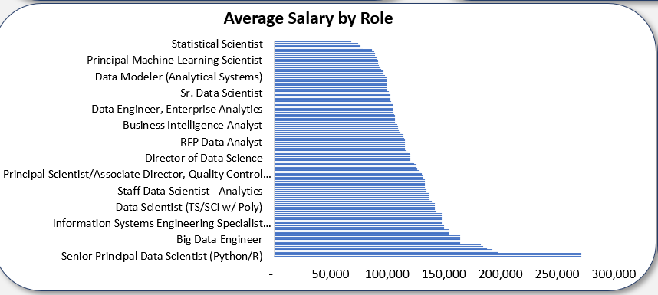
Problem 1: Salary Insights Across Roles
Question: Which job titles have highest average salary estimates?
Top 5 Roles Highest Paying Roles
1. Senior Principal Data Scientist (Python/R) $272k
2. Manager, Field Application Scientist, Southeast $272k
3. COMPUTER SCIENTIST - ENGINEER - RESEARCH COMPUTER SCIENTIST - SIGNAL PROCESSING $272k
4. Scientist / Group Lead, Cancer Biology $198k
5. Data Scientist(s)/Machine Learning Engineer $198k
6. Scientist - Machine Learning $193k
7. Real World Science, Data Scientist $188k
8. Chief Scientist $185k
9. Development Scientist, Voltaren $185k:

Slide 8
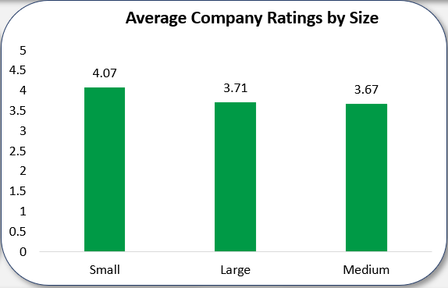
Problem 2: Company Ratings and Size Question: Do larger companies tend to have higher Glassdoor ratings?
Company sizes vs Ratings
Large Companies(>5000 Employees) 3.71 Medium Companies (500-5000 Employees) 3.67 Small Companies(<500 Employees) 4.07

Slide 9
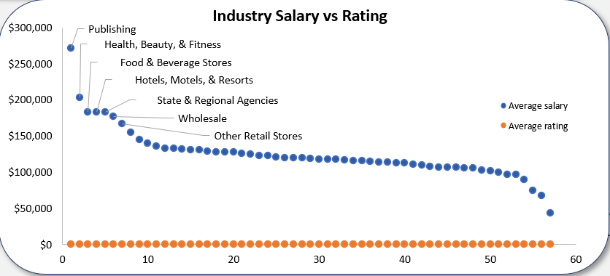
Problem 3: Industry & Sector Analysis Question: Which industries and sectors offer the best combination of high salaries and strong ratings?
Top 5 Industries and Sectors
Publishing $271,500 4.7
Health , Beauty, & Fitness $203,750 4.0
Food and Beverages Stores $183,000 3.7
Hotels, Motels, & Resorts $183,000 3.5
State & Regional Agencies $183,000 3.2
Whole sale $177,000 2.63
Other Retail Stores $167,333 3.67

Slide 10
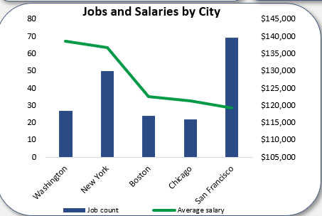
Problem 4: Location & Market Opportunities
Top 5 Cities by Job Count and Salaries
Question: Which U.S. cities offer the most Data science job opportunities and best pay?
Washington 27 $138,555.56
New York 50 $136,680
Boston 24 $122,583.33
Chicago 22 $121,318.18
San Francisco 69 $119,224.64

Slide 11
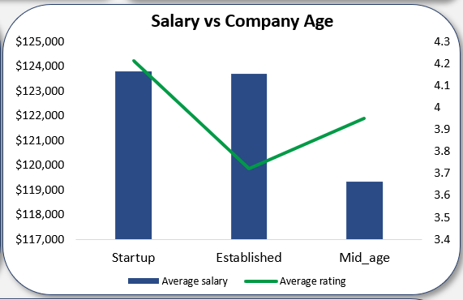
Problem 5: Company Age and Salary Relation
Company Age vs Salary:
Question: Do older, more established companies offer higher salaries?
Start ups (≤ 5 years) $123,774 4.2 Mid-age (6–15 years) $123,706 3.72 Established (> 15 years) $119,337 3.95

Slide 12
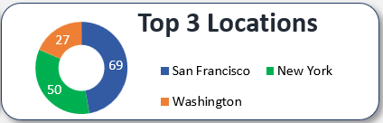
Top 3 Locations for Job count:
San Francisco 69 New York 50 Washington 27

Slide 13
RECOMMENDATIONS:
Recruitment for high value roles should be between Senior Data Scientist & ML Engineers.
Focus on top cities (San Francisco, New York city, Washington).
Keep Salaries competitive in Health and Finance Sectors.
Highlight growth potential to attract talent to start-ups.
Implement a skill-based hiring strategy (to align required skills with salary levels)
Develop a data driven compensation dashboard to continuously monitor pay equity and market trends.

Slide 14

Thanks for having us

